Slide 1
Elmir Guliyev
Neptune: HVABRZ
Course name: Stream Mining
3rd Project - DWM

Slide 2

What is a DWM Algorithm?
Dynamic weighted majority (DWM) maintains an ensemble of base learners, predicts using a weighted-majority vote of these "experts", and dynamically creates and deletes experts in response to changes in performance.

Slide 3
Most usual experiments
Stagger
SEA

Slide 4
Main reason behind
To be able to catch real time updates and inputs
To be able to delete overdue ones.

Slide 5
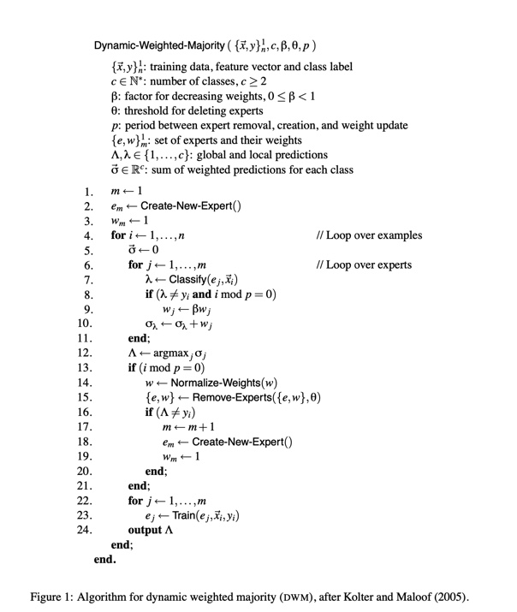
Algorithm
Dynamic-Weighted-Majority

Slide 6
Specific data[Elmir]
Generating new data every runtime
Identifying sleeping experts based on the consideration of the weights, days

Slide 7
Used materials
DWM Research paper given by the professor
Google
Github
Kaggle

Slide 8
Thank you for your attention.

